Slide 1

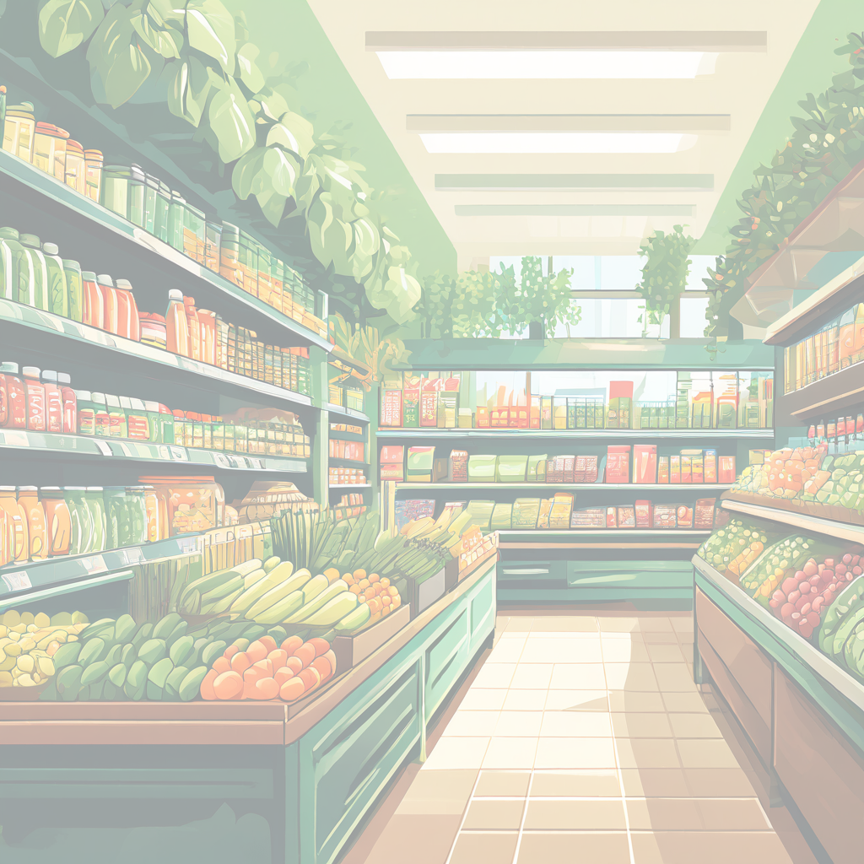

Slide 2

DEVELOPED BY
LEADER Aditya Das (Front end & Backend)
Ashok Kumar (Front end & backend)
COLEADER SUMAN DAS(Presentation)
Mayank Dubey(Documentation)
Ariyan Kumar Gupta (Documentation & Logo design)

Slide 3


Sofware and Resources used
Front-end Development
PYTHON
Back-end Development
MySQL

Slide 4
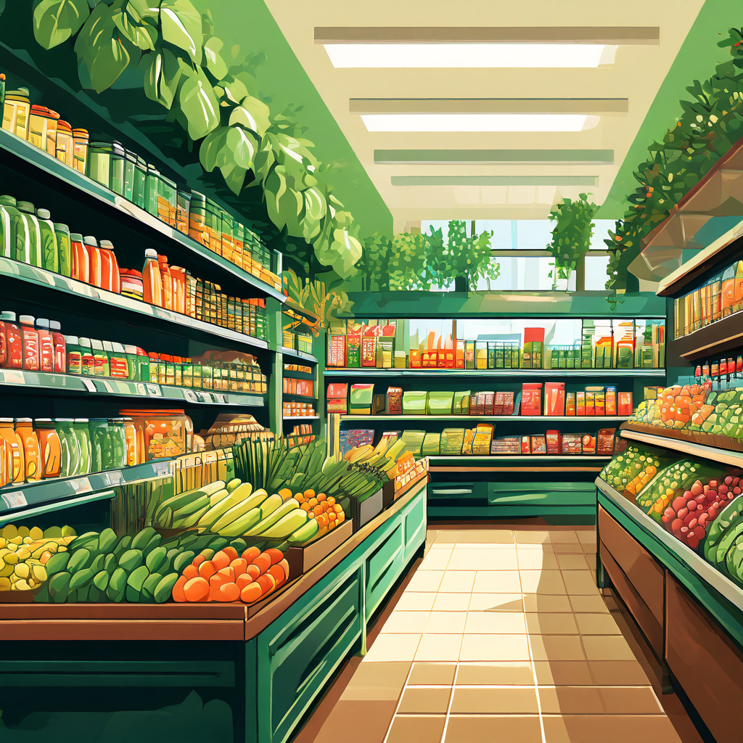
Introduction to "GROCERIA"
Revolutionize your grocery shopping experience with GROCERIA" - the one-stop app for all your fresh food needs."

Slide 5
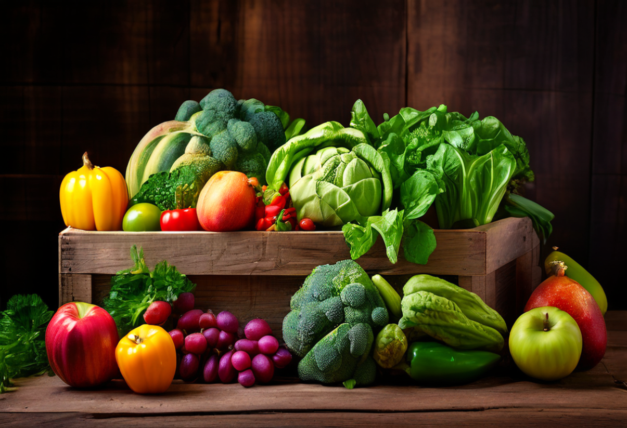

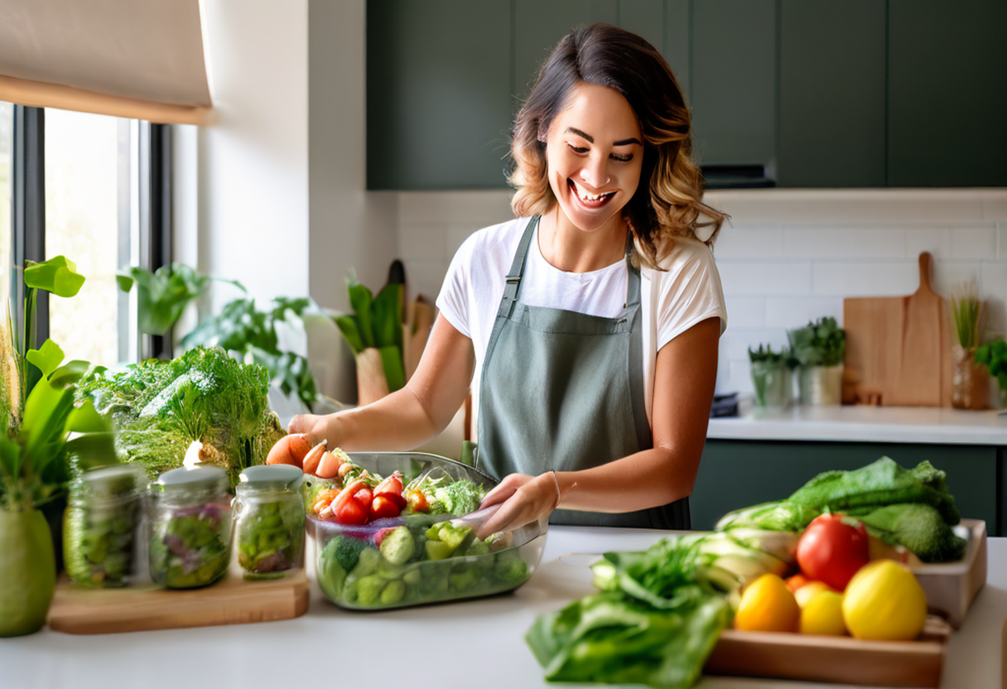
WHY GROCERIA ?
Farm Fresh Produce
We deliver the finest quality fruits and vegetables straight from local farms to your doorstep.
Convenient Delivery
With our reliable delivery service, getting your groceries has never been easier. We bring the farm to you!
Quality You Can Trust
Our commitment to freshness and sustainability ensures you receive only the best products for your family.

Slide 6
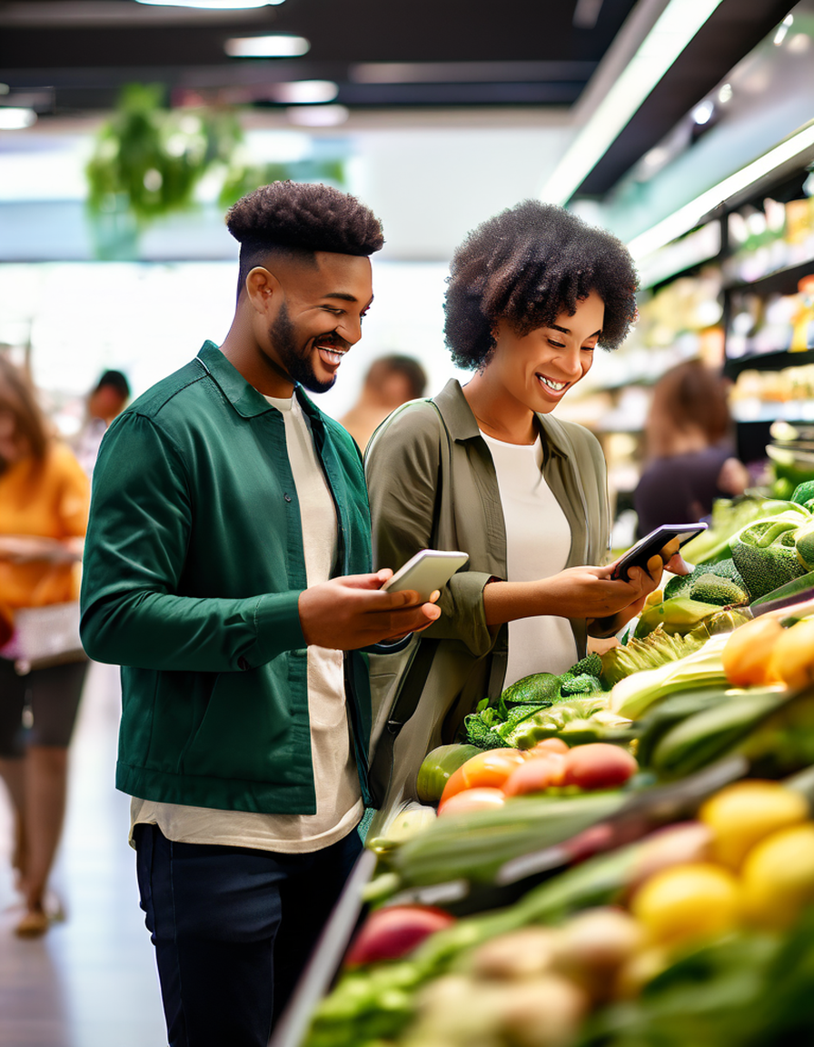
GROCERY SHOPING EXPERIENCE
BROWSE
Choose from wide variety of vegies , meats,and beverages,each categorically divided.
Add To Cart
Seamlessly add items to your cart with just a few taps
Checkout
Securely complete your purchase with various payment options.

Slide 7
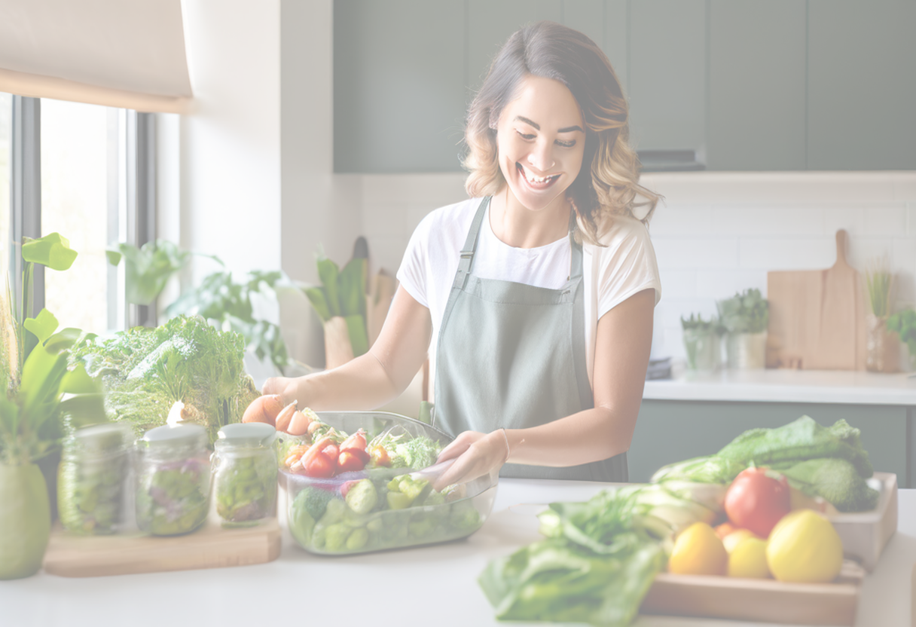
NOW LETS GET INTO THE APP WE DESINGED

Slide 8
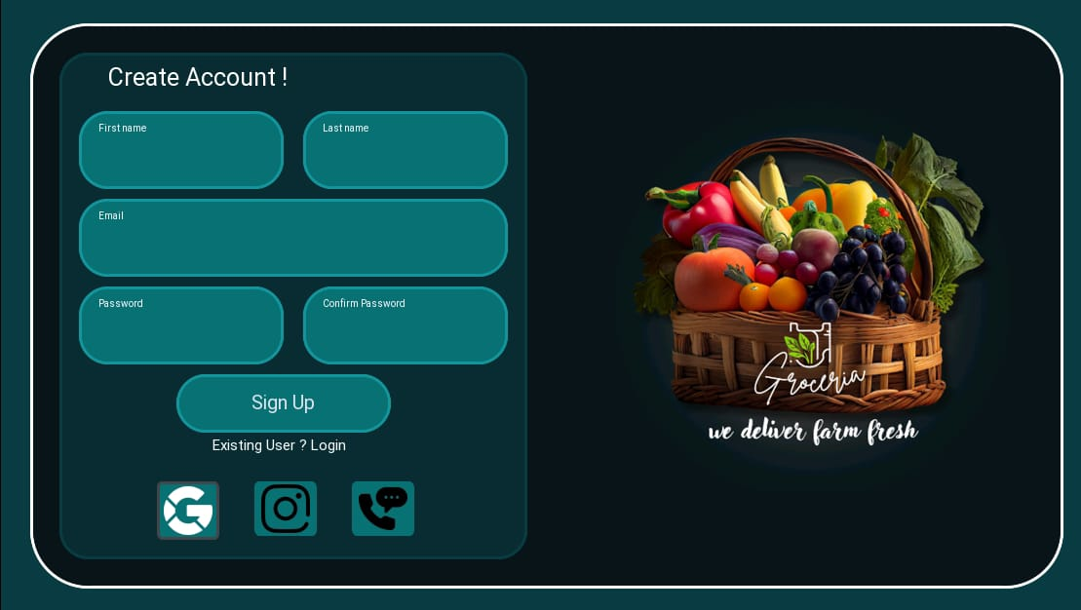
Sign Up Page
New users can sign up for a Groceria account by providing their basic information, including name, email, and password. This creates a secure profile to manage their grocery orders.

Slide 9
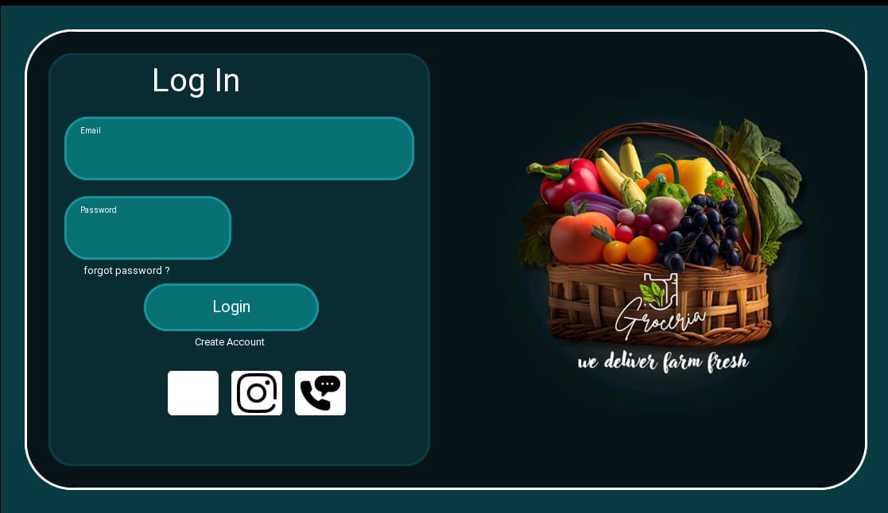
Login Page
Registered users can log in to their Groceria account using their email and password. This grants them access to their personalized shopping history and preferences.

Slide 10
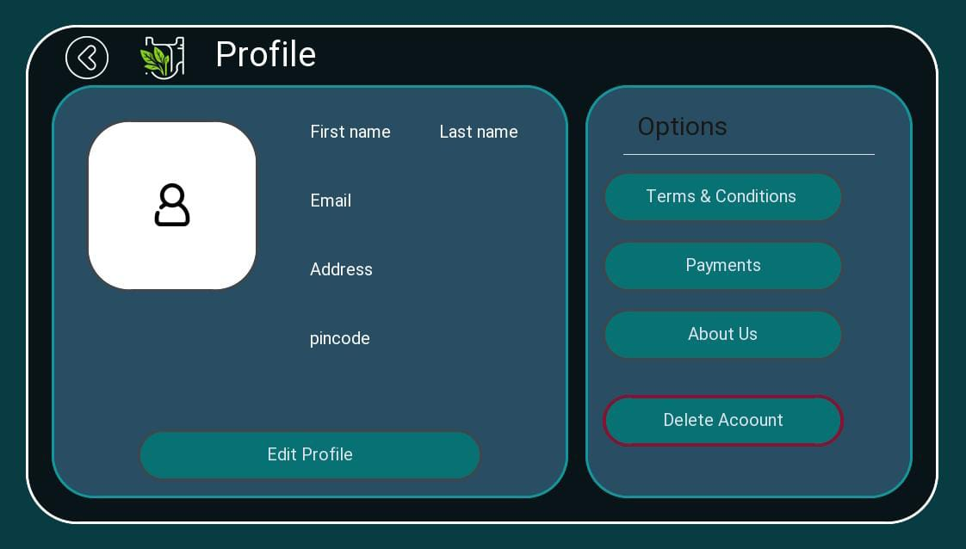
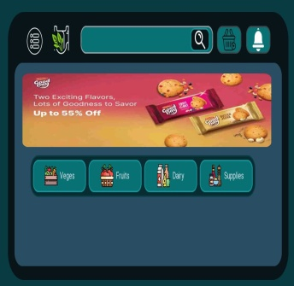
User Profile
Registered users can manage their account by opening this page by clicking the
symbol
They can also delete their account if they wish

Slide 11
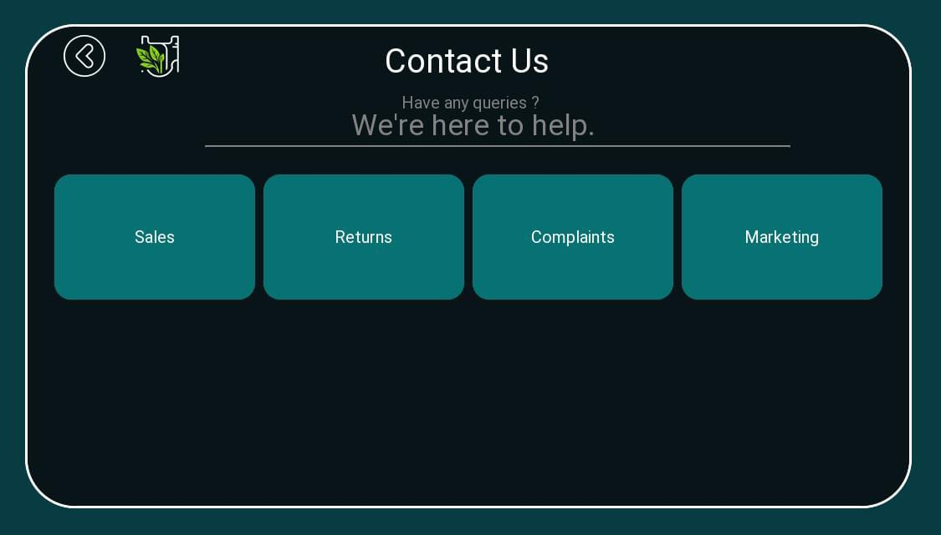
Contact Us Page

Slide 12
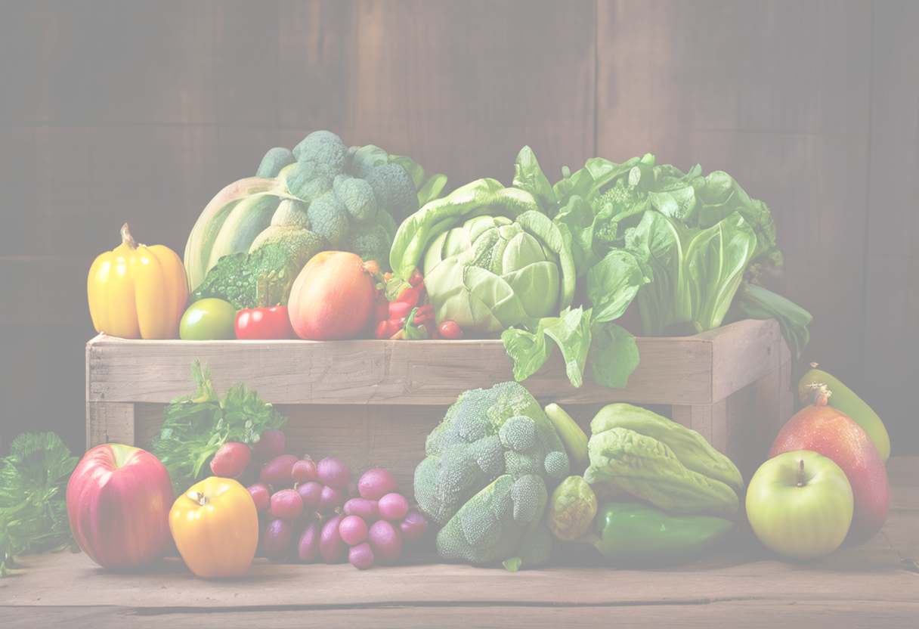
FEATURES
IN
GROCERIA

Slide 13
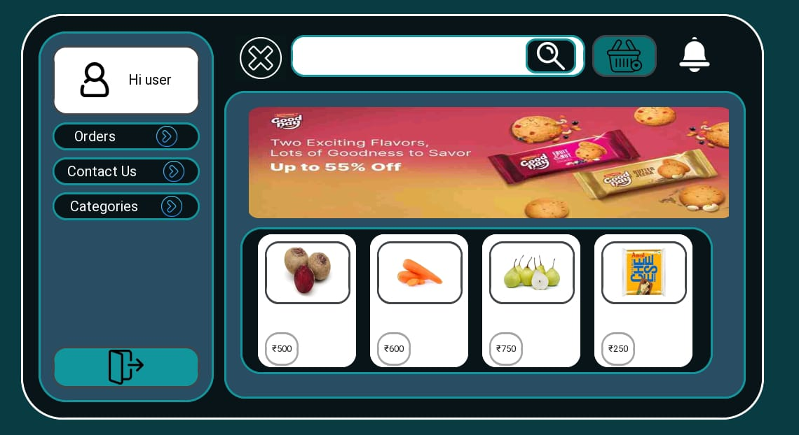
User Interface Design
Intuitive Navigation
Seamless user flow and clear categories for easy browsing

Slide 14
User Interface Design
Detailed Product Imagery
Comprehensive information to make informed purchasing decisions.

Slide 15
User Interface Design
Streamlined Checkout
Simplified process to complete purchases efficiently.

Slide 16
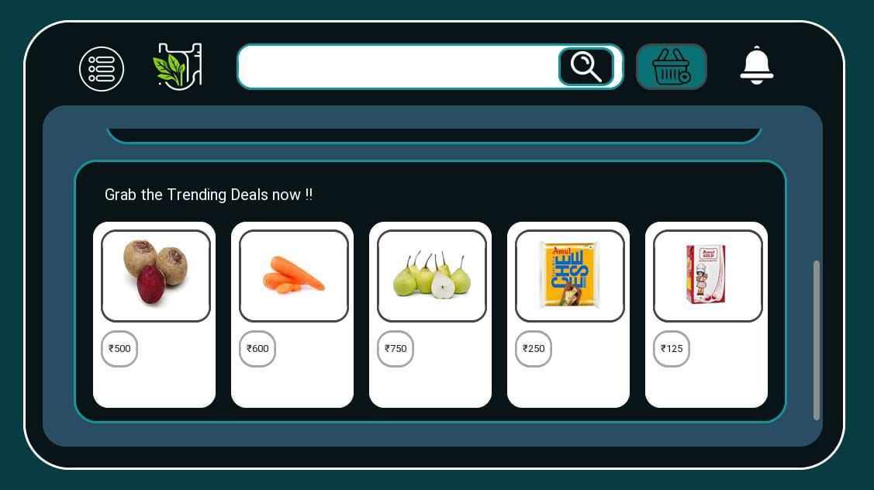
GET THE TRENDING DEALS

Slide 17
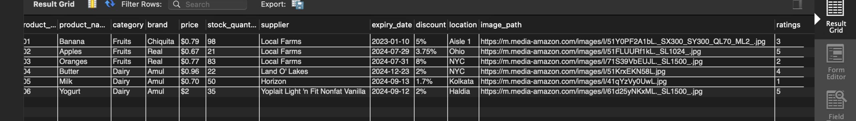
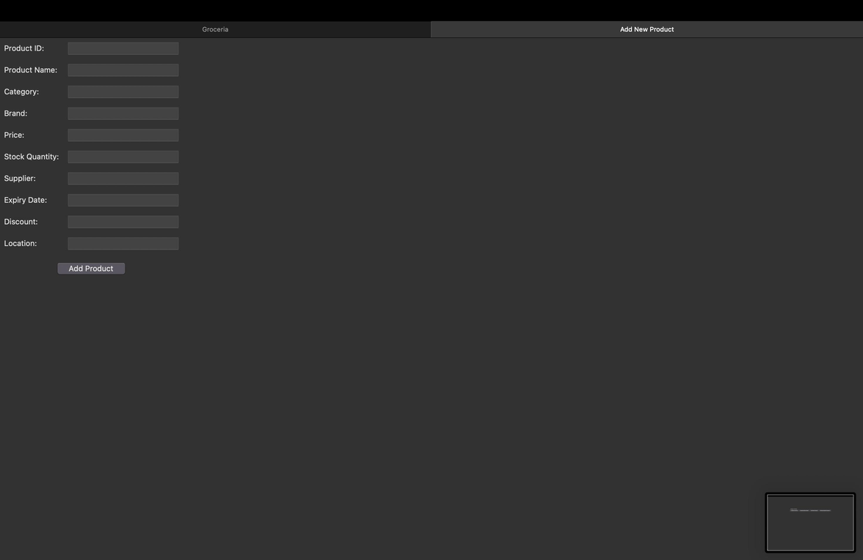
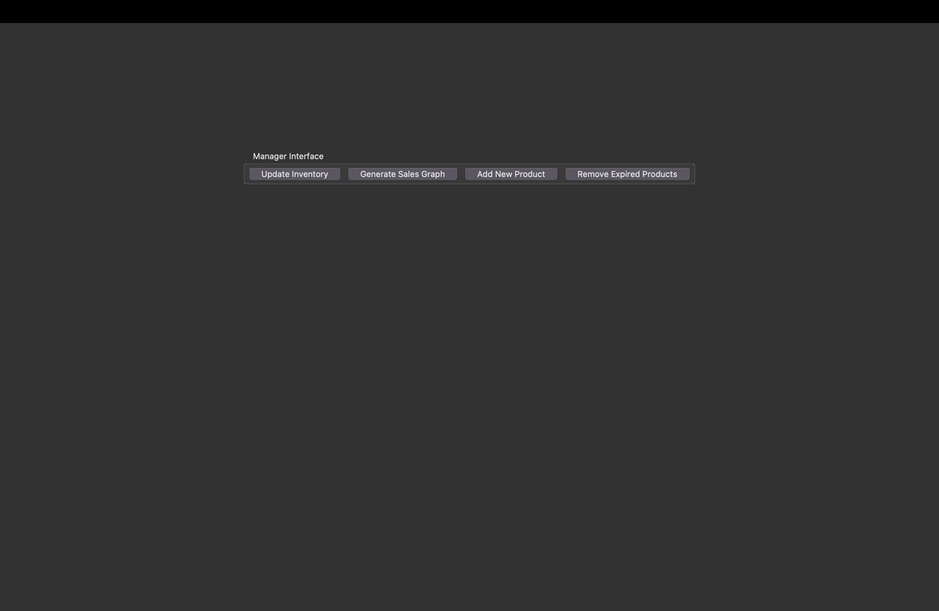
Peek Into the Database

Slide 18
Scope Of Improvement
Better User Interface
More Features
Better Presentation
More Development in Backend

Slide 19
THANK YOU!
Have a great day ahead.

